Slide 1
CS 341: Web Technologies
Dennis Owusu

Slide 2
REST API

Slide 3
Web API
API (Application Programming Interface) defines how two software systems communicate/exchange information (protocol).
Web API is API on the web.

Slide 4
REST API
An approach to constructing web APIs.
It imposes certain constraints to achieve certain goals.
Platform Independence: Any client can call the API regardless of implementation
Decoupled Service Evolution: The client and server can evolve independently*

Slide 5
REST API
Application is a custodian of resources. E.g. data, service
Each resource has a unique identifier.
Interaction is through exchange of representations of resources.
JSON is a popular format for these representations
REST is usually used with http
Uniform set of methods: GET, POST, PUT, PATCH, DELETE
Stateless Request Model
Good for scalability

Slide 6
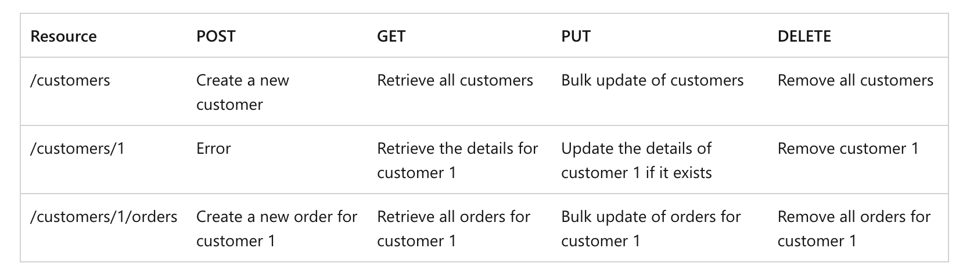
REST API

Slide 7
REST API
POST, PUT, PATCH
POST creates resource
PUT creates resource or updates resource
PUT must be idempotent
PATCH performs partial update to resource

Slide 8
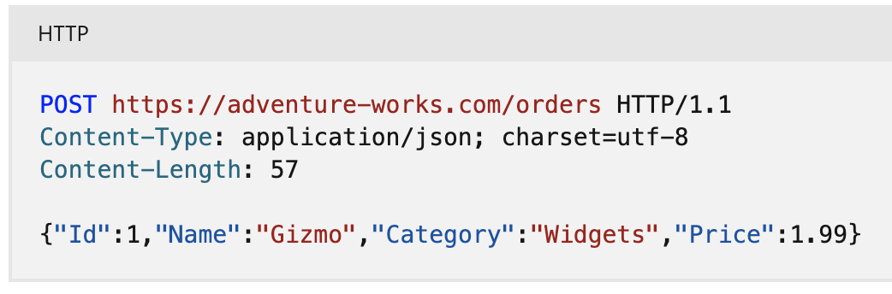
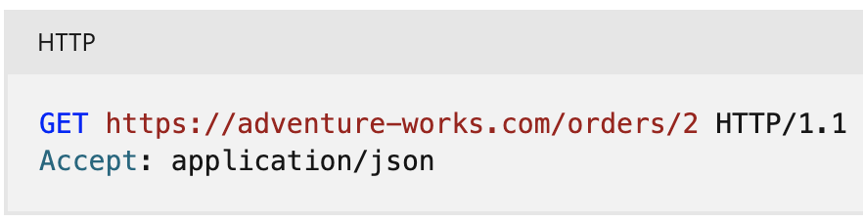
REST API
Request Header contains request type; Request body contains representation.
E.g. POST and GET
The format of the body is called media type or MIME
E.g. JSON, XML
Specified in header using Content-type

Slide 9
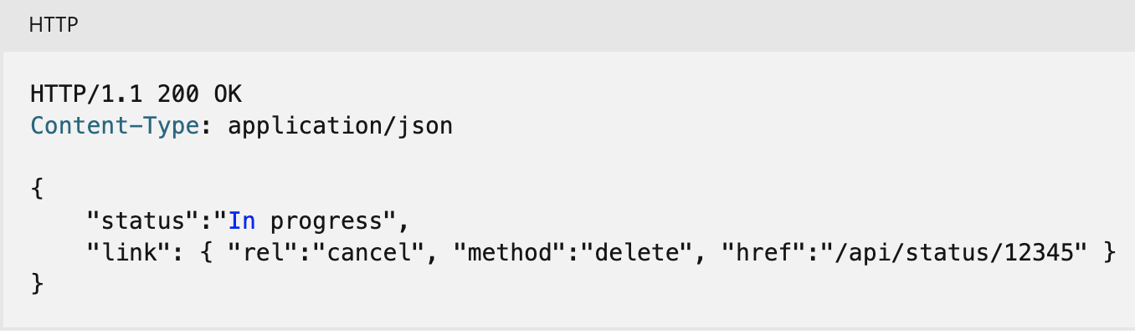
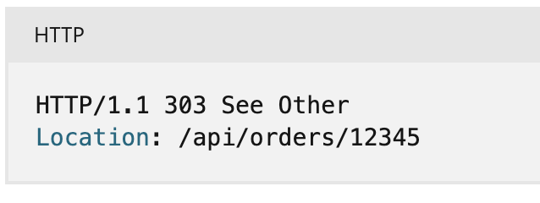
REST API
Use status codes to provide status
200 (Ok)
404 (Not Found)
201 (Created)
400 (Bad Request)
Asynchronous Operations
202 Accepted
Expose endpoint for checking status of operation

Slide 10
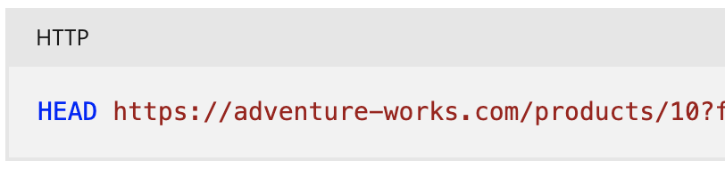
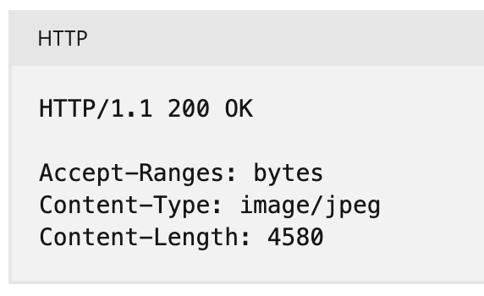
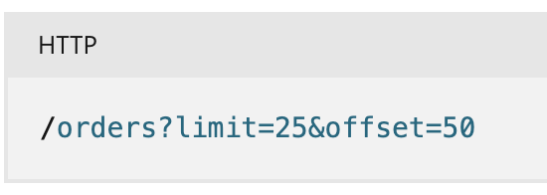
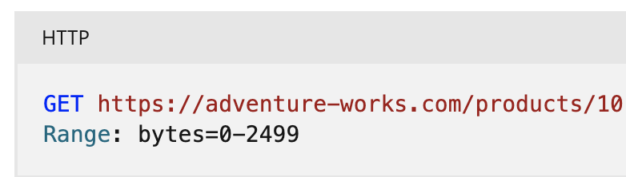
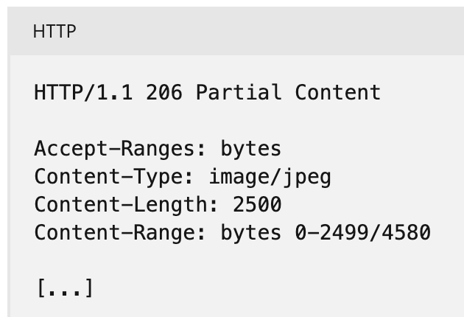
REST API
Filter & Paginate for a large collection
Partial Requests for Large Binary Files
HEAD to see what’s available (GET with empty body)
Use range to get partial response
206 to indicate partial response

Slide 11
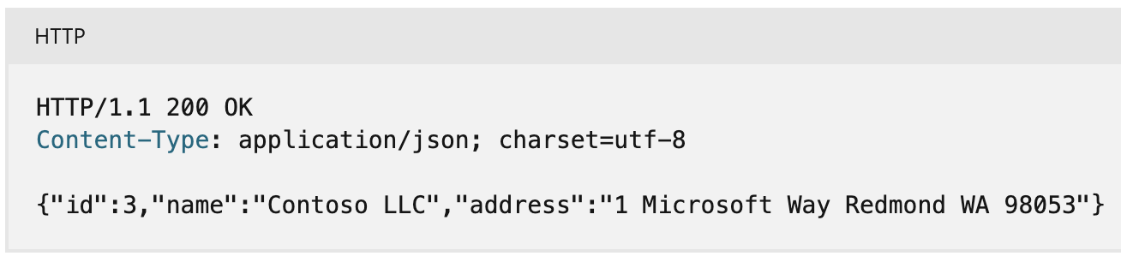
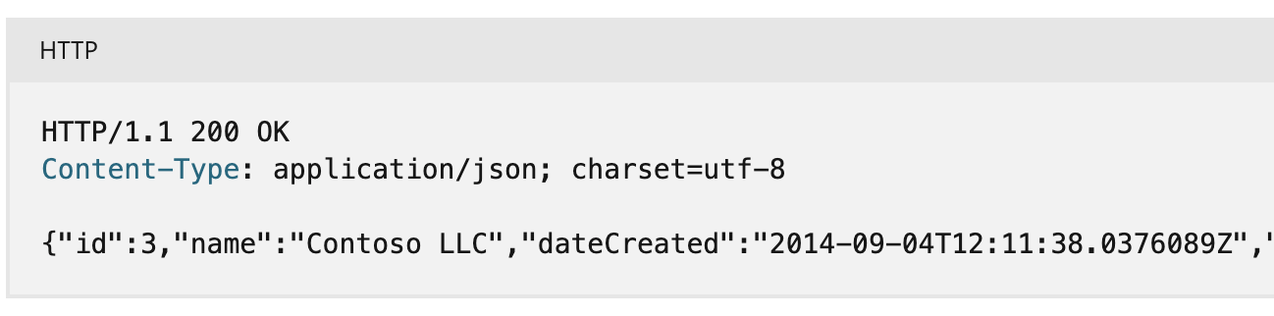
Versioning a REST API
No versioning can work sometimes

Slide 12
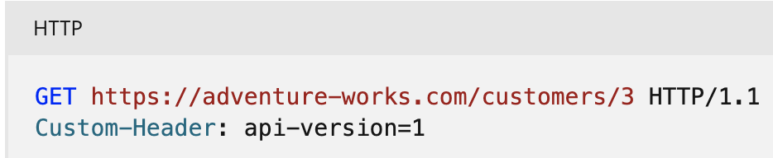
Versioning
URI Versioning
It’s cumbersome (gets unwieldy)
HATEOAS?
Query String Versioning
Default to say 1
HATEOAS?
Header Versioning
Default to 1 on client side
HATEOAS

Slide 13
CLOUD PLATFORMS

Slide 14
CLOUD DATABASES

Slide 15
Cloud Databases
Cloud database is database in the cloud.
Deployment
Delivery
Accessibility
Provides similar advantages to Cloud in general
Speed
Scaling
Pay-for-use
Security (arguable)

Slide 16
Cloud Databases
Relational Databases
Highly structured
Rows and columns
Predefined relationships
Fixed data schema
SQL to query and manipulate data
MySQL, PostgreSQL, SQL Server, Oracle, Spanner, Cloud SQL
Non-relational Databases (NoSQL)
Unstructured
No clearly defined schema
Handle data with different formats
MongoDb, Cassandra, Hbase, Cloud Bigtable

Slide 17
Firestore
NoSQL Database from Google Cloud
Interaction can be client-side or server-side
Real-time capabilities
Offline capabilities
Collections -> Documents -> Field-value

Slide 18
SERVERLESS

Slide 19
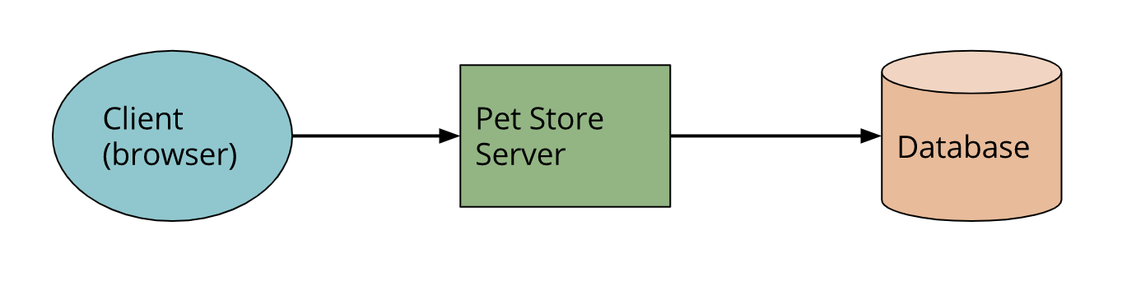
Traditional Architecture
Application logic - page navigation, authentication, searching, transactions - implemented on server.

Slide 20
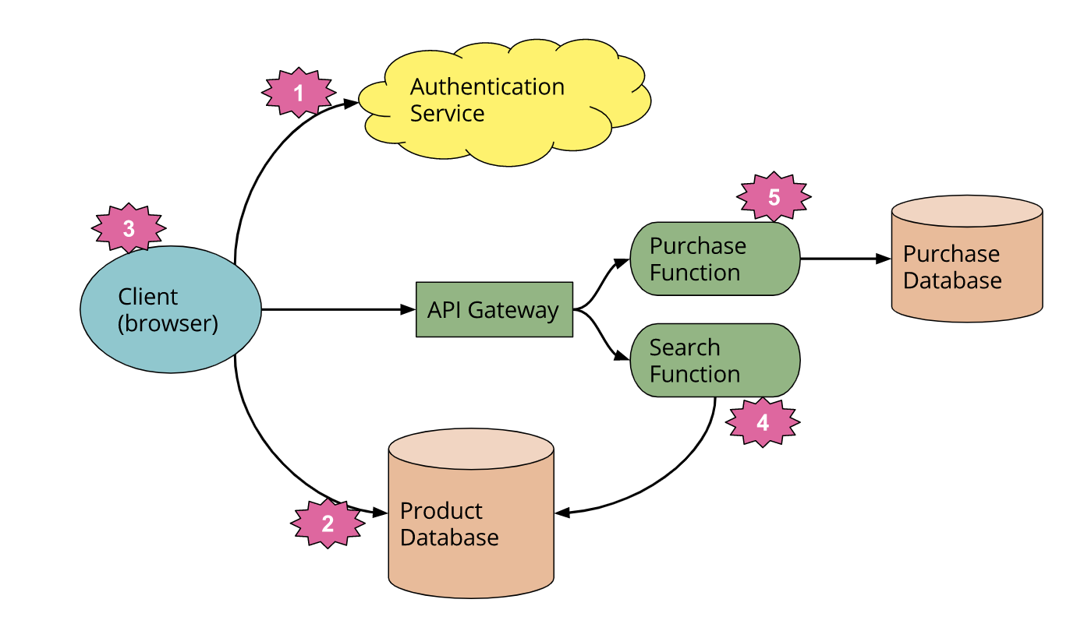
Serverless Example
Third-party authentication service
Client access to cloud database
Rich client - tracking session, navigation, view/display construction
On-demand server side logic

Slide 21
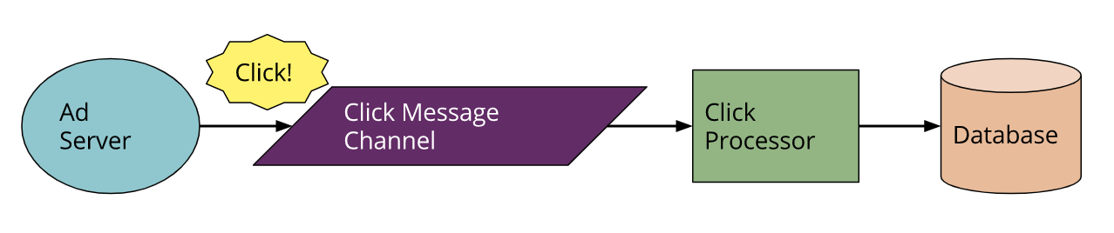
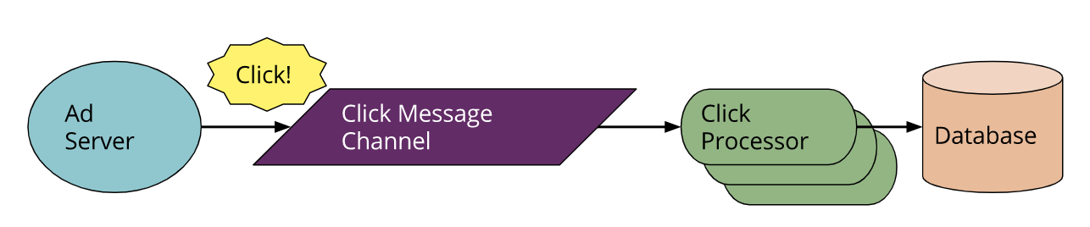
Message Driven Serverless Example
Traditional
Serverless

Slide 22
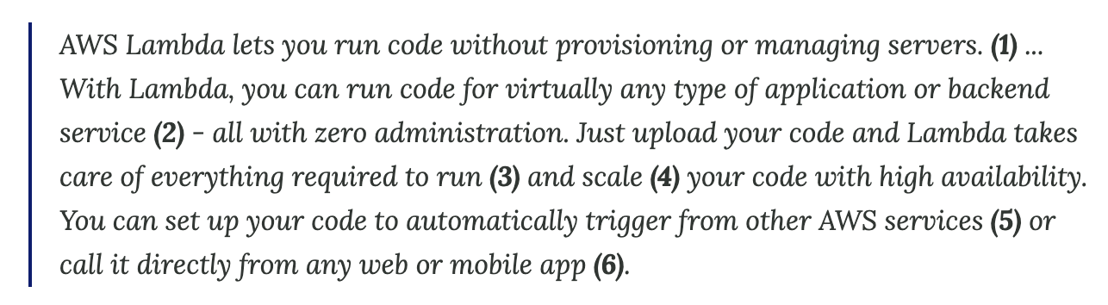
Function as a Service

Slide 23
FAAS “Limitations”
State
State needed between invocations must be externalized
Execution Duration
Timeout
Start-up Latency
“Cold-starts”

Slide 24
Benefits of Serverless
Reduced Operational Costs
Reduced Development Costs
Reduced Scaling Costs
Easier Operational Management
Reduced packaging and deployment complexity
Time to market and continuous experimentation
Arguably Greener
Only when needed

Slide 25
Drawbacks
Vendor control
Multitenancy Problems
Vendor lock-in
Security concerns
Increased surface area
BAAS database - no longer have server-side barrier
Many FAAS - IAM configurations
Repetition of client logic
Goes Against “Backend for Frontend” pattern
No in-server state for FAAS

Slide 26
Implementation Drawbacks
Execution duration
Startup latency
Integration testing difficulty
Debugging (Creating local environment)

Slide 27
FLUTTER WEB

Slide 28
Rich Client Applications
Single Page Apps (SPA)
Essential to the serverless paradigm
Rich web clients interact similar to mobile applications (Android, IOS)
Angular (Google), React (Facebook), Vue, Flutter
React/React Native for Cross-platform
Flutter is cross-platform: flutter web

Slide 29
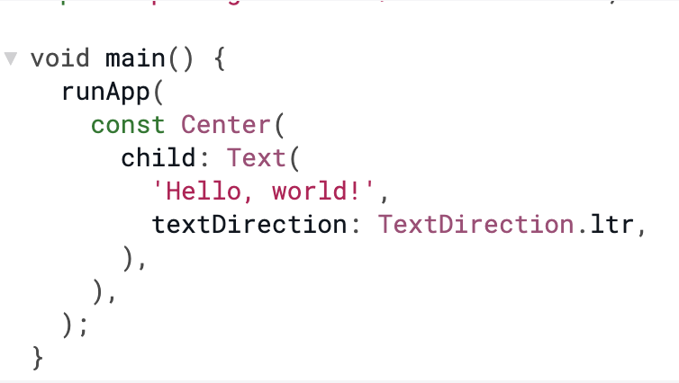
Widgets
Widgets are the building blocks
Legos?
Root Widget covers screen

Slide 30
Basic Widgets
Text
Row, Column
Stack
Children can be positioned right, left, top, bottom
Container
Margins, padding

Slide 31
Material Design
“Material Design is an adaptable system of guidelines, components, and tools that support the best practices of user interface design. Backed by open-source code, Material Design streamlines collaboration between designers and developers, and helps teams quickly build beautiful products.”
m3.material.io

Slide 32
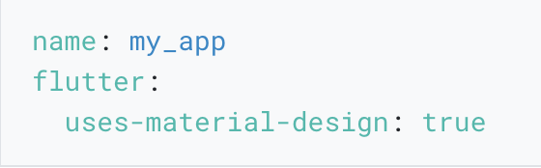
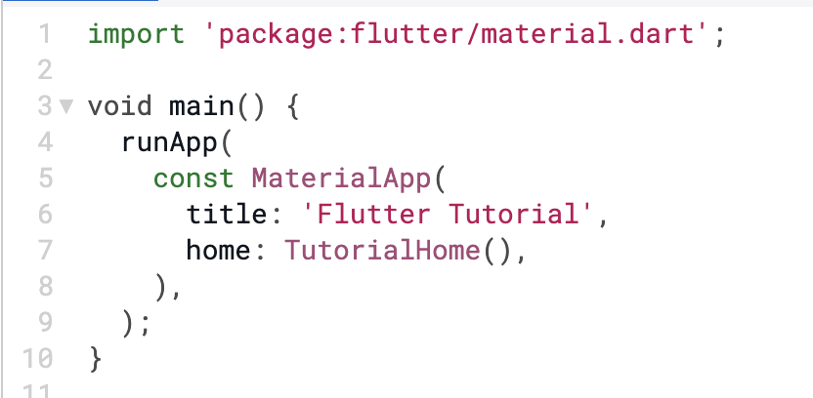
Material Design
pubspec.yaml

Slide 33
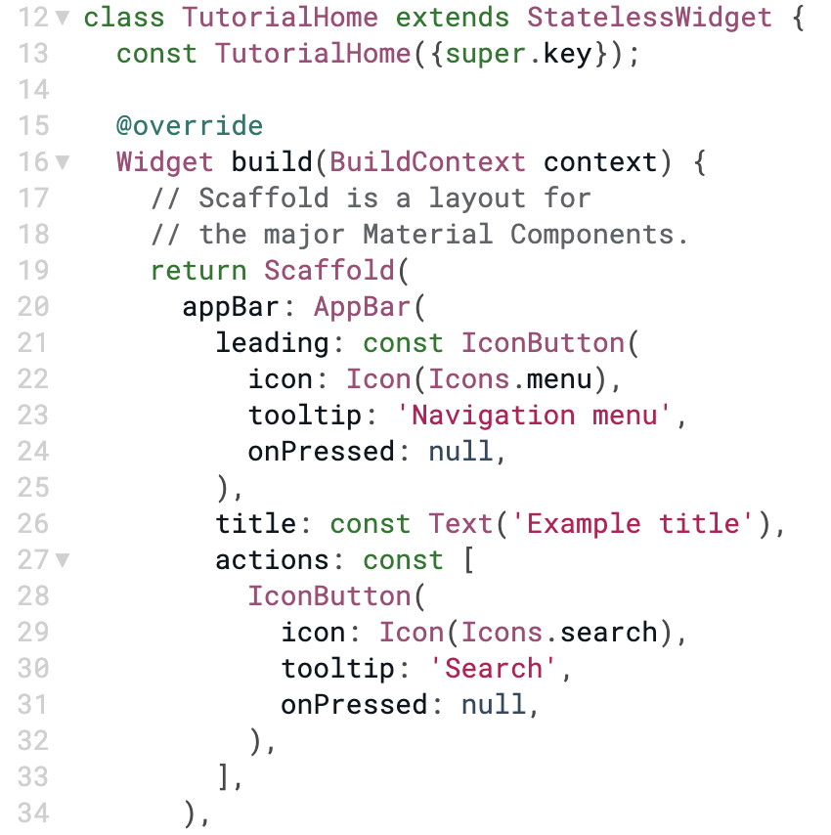
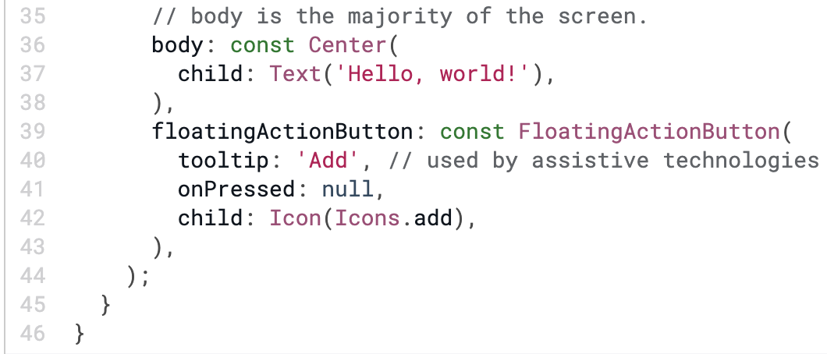
Material Design
\\

Slide 34
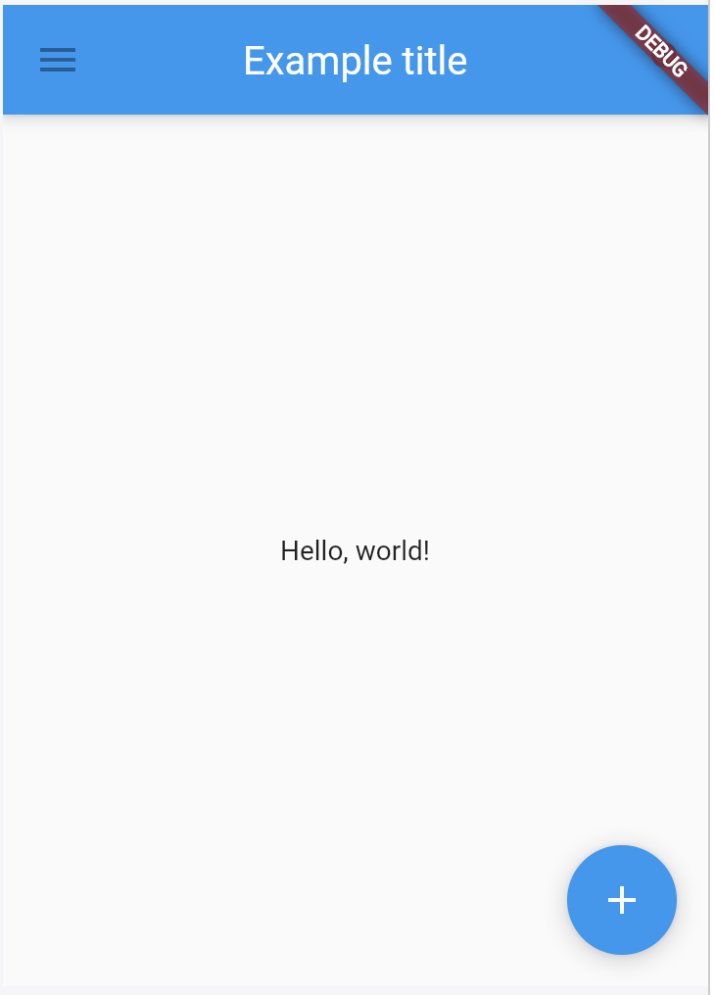

Slide 35
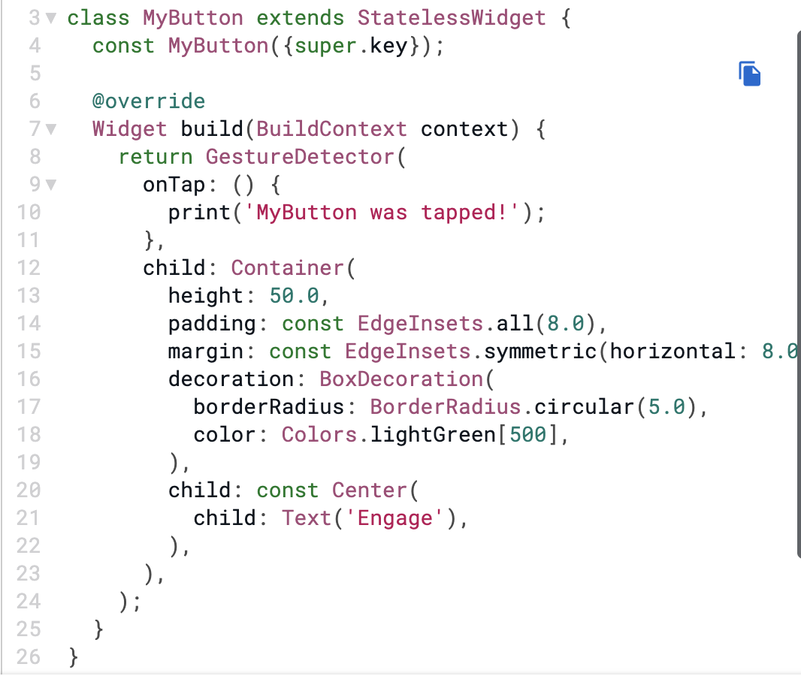
Handling Gestures

Slide 36
Handling Gestures

Slide 37
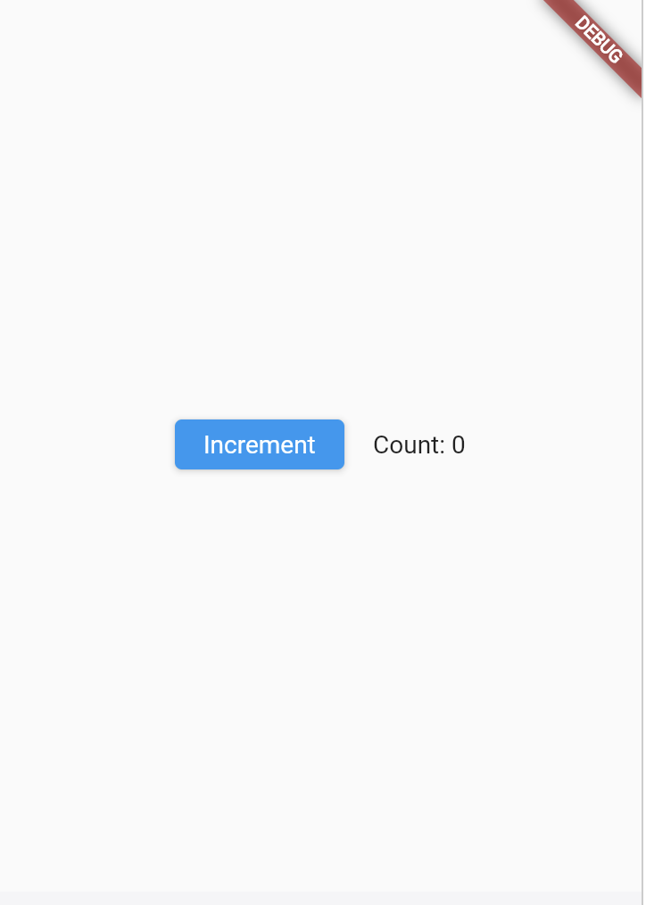
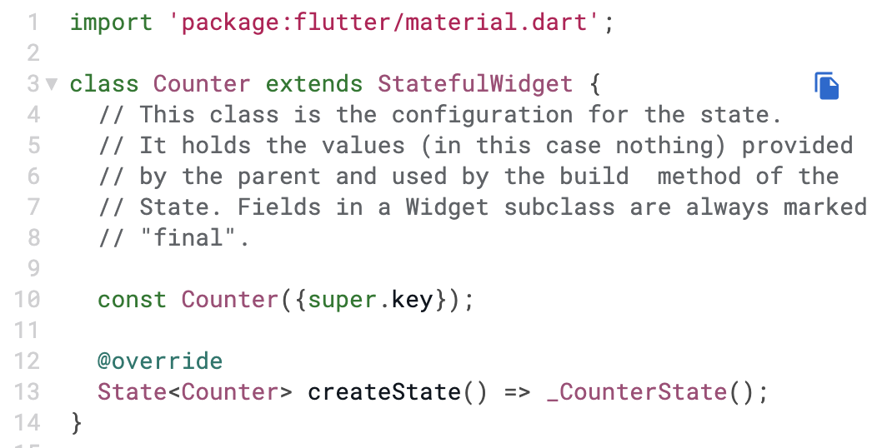
Stateful Widgets
Stateful widgets needed for changing widget in response to user input.

Slide 38
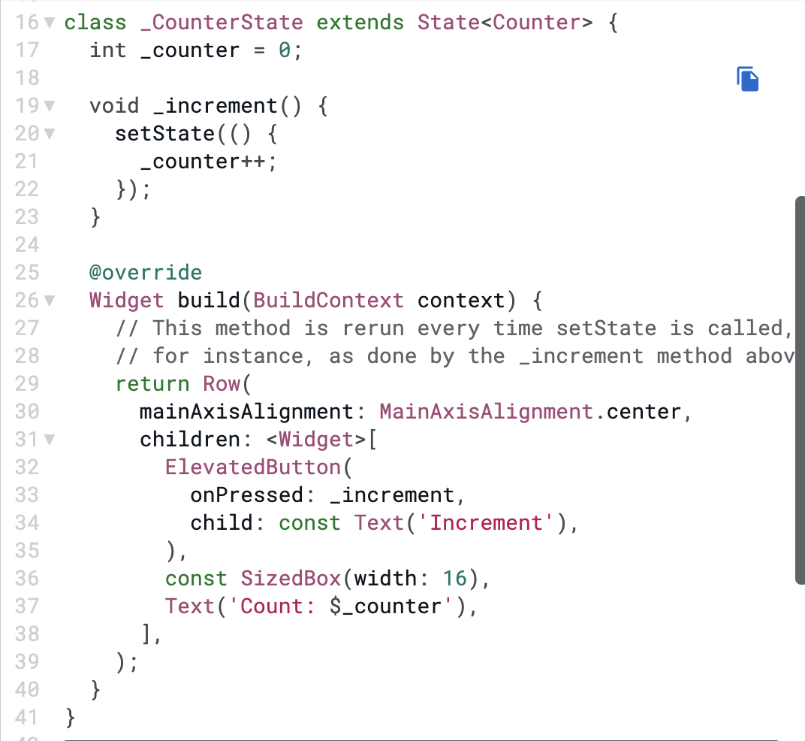
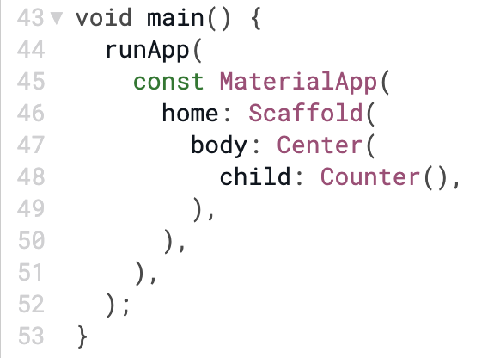
Stateful Widgets

